Slide 1
Strong Slot and Filler Structures

Slide 2
The main problem with semantic networks and frames is that they lack formality; there is no specific guideline on how to use the representations.
Strong Slot and Filler Structures typically:
Represent links between objects according to more rigid rules.
Specific notions of what types of object and relations between them are provided.
Represent knowledge about common situations.
There are two types of strong slots and their filler structures – Conceptual dependencies and Scripts

Slide 3
Conceptual Dependency
Conceptual dependency (CD) is a theory of natural language processing which mainly deals with representation of semantics of a language.
Conceptual Dependency originally developed to represent knowledge acquired from natural language input.
The goals of this theory are:
To help in the drawing of inference from sentences.
To be independent of the words used in the original input.
That is to say: For any 2 (or more) sentences that are identical in meaning there should be only one representation of that meaning.
To provide facilities for the system to take part in dialogues and answer questions

Slide 4
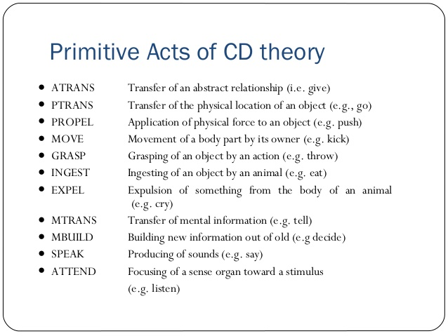

Slide 5
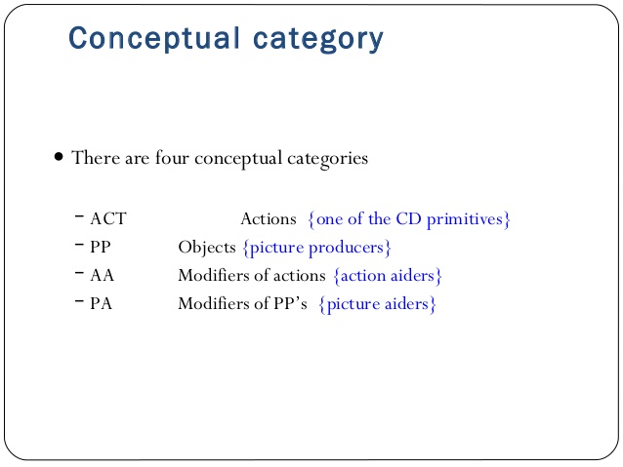

Slide 6
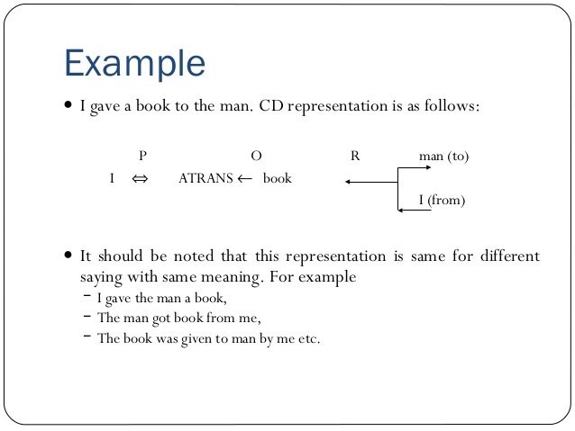

Slide 7
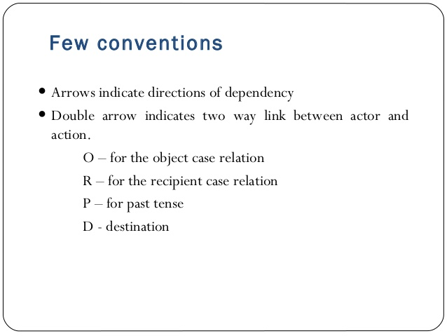

Slide 8
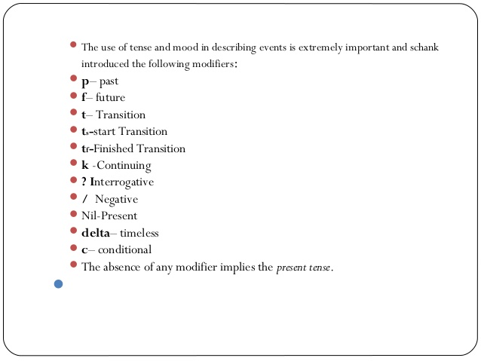

Slide 9
Conceptual Dependency Rules
Rule-1: It describes the relationship between and the actor and the event he or she causes.
Rule-2: It describes the relationship between a PP and a PA that is being asserted to describe it.

Slide 10

Rule-3: It describes the relationship between two PPs, one of which belongs to the set defined by the other.
Rule-4: It describes the relationship between a PP and an attribute that has already been predicated of it.

Slide 11
Rule-5: It describes the relationship between two PPs, one of which provides particular kind of information about the other. The three most common types of information to be provided in this way are:
Possession - POSS-BY
Location – LOC
Physical Containment – CONT

Slide 12

Rule-6: It describes the relationship between an ACT and the PP that is the object of that ACT.
Rule-7: It describes the relationship between an ACT and the source and, the recipient of the ACT.

Slide 13

Rule-8: It describes the relationship between an ACT and the instrument with which it is performed.
Rule-9: It describes the relationship between an ACT and its physical source and destination.

Slide 14

Rule-10: It represents the relationship between a PP and a state in which it started and another in which it ended.
Rule-11: It describes the relationship between one conceptualization and another that causes it.

Slide 15
Rule-12: It describes the relationship between a conceptualization and the time at which the event it describes occurred.
Rule-13: It describes the relationship between one conceptualization and another that is the time of the first.

Slide 16
Rule-14: It describes the relationship between a conceptualization and the place at which it occurred.

Slide 17
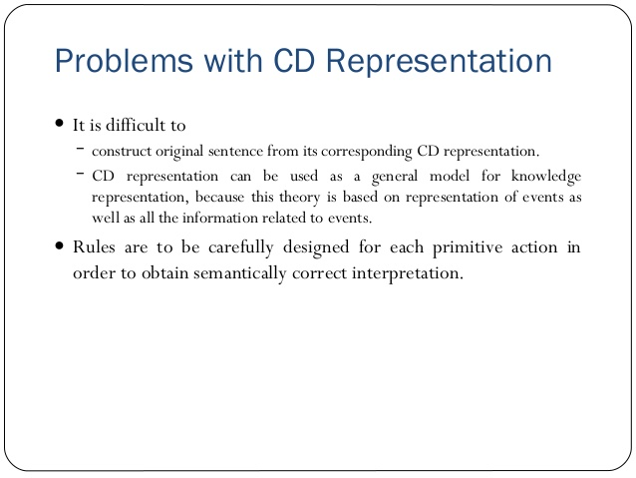

Slide 18
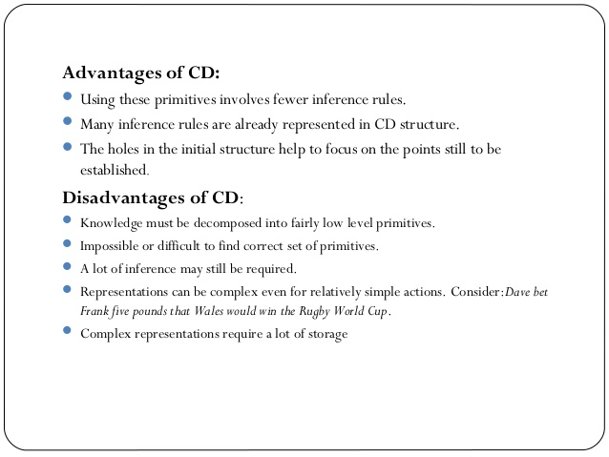

Slide 19
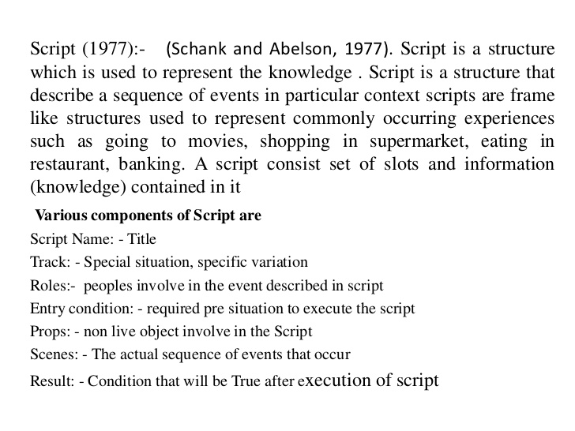
Scripts

Slide 20
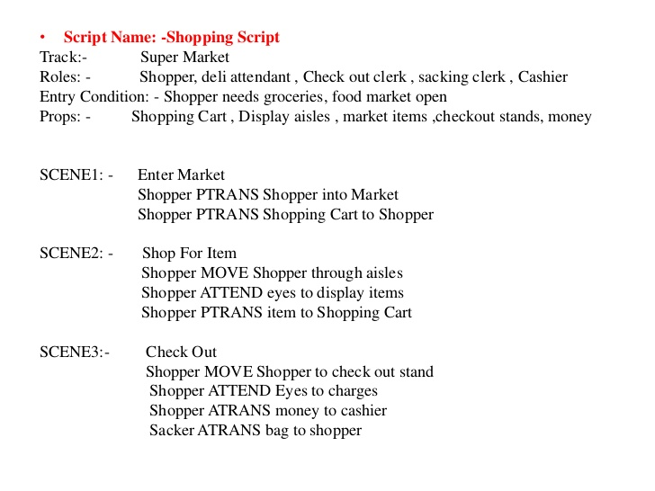
Script for Super market

Slide 21
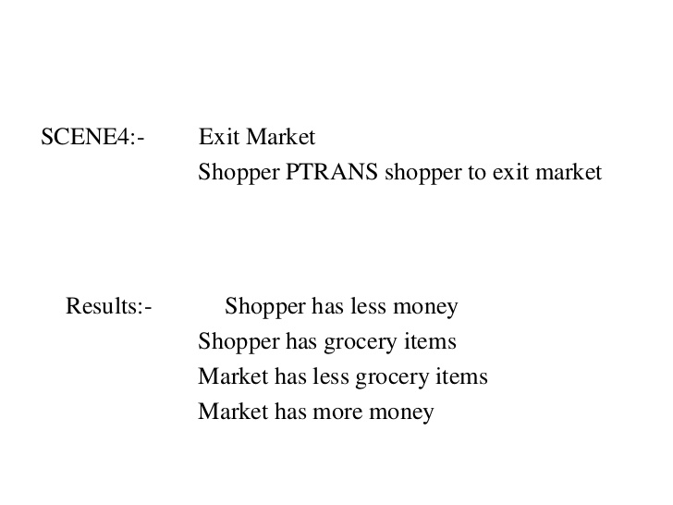

Slide 22
Script for Robbing a bank
This might involve:
Getting a gun.
Hold up a bank.
Escape with the money.
Here the Props might be
Gun, G.
Loot, L.
Bag, B
Get away car, C.
The Roles might be:
Robber, S.
Cashier, M.
Bank Manager, O.
Policeman, P.

Slide 23
The Entry Conditions might be:
S is poor.
S is destitute.
The Results might be:
S has more money.
O is angry.
M is in a state of shock.
P is shot.
There are 3 scenes: obtaining the gun, robbing the bank and the getaway.

Slide 24
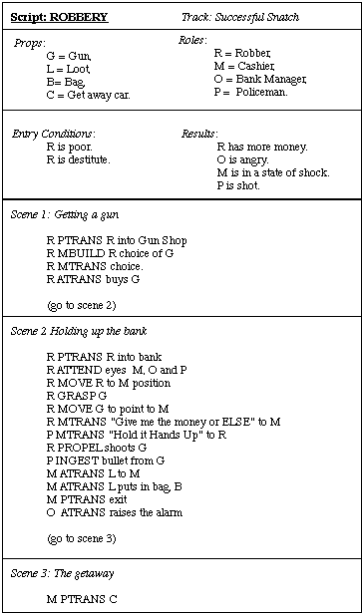

Slide 25
Advantages of Scripts:
Ability to predict events.
A single coherent interpretation may be build up from a collection of observations.
Causal relationships between events exist.
Disadvantages:
Less general than frames.
May not be suitable to represent all kinds of knowledge.

